Slide 1
Textual Relations Annotator with Feedback
StARLinG Labs
Abhiramon Rajasekharan

Slide 2
Index
Objective
Implementation
Demo
Future extensions

Slide 3
Objectives
Create GUI for selecting phrases as positive examples.
Convert document and positive examples into predicates for training and testing.
Automate model training and testing using Boost SRL software.
Display the test results in color-coded format.

Slide 4
Implementation

Slide 5
Features implemented
Phrases can be selected and converted into positive examples using GUI (web interface).
Text document and positive examples are converted into predicates (using rnlp python module).
Appropriate files are created, model is training and testing is done using boost srl software (with bash scripts).
Results after testing are extracted and displayed in color-coded format on results page.

Slide 6
Softwares used
Python 2, python libraries: Flask, rnlp, os, sys
HTML
CSS
Java Script
Bash scripts (for Linux computers)
Boost SRL package (https://starling.utdallas.edu/software/boostsrl/)

Slide 7
Demo

Slide 8
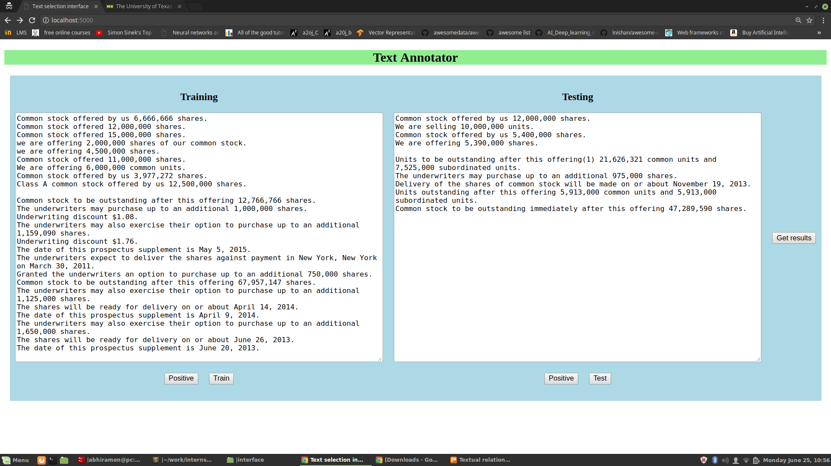

Slide 9
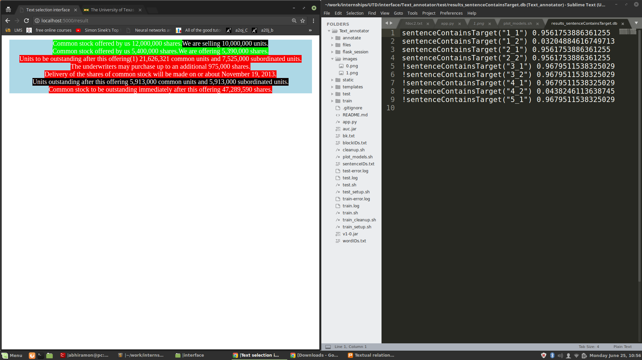

Slide 10
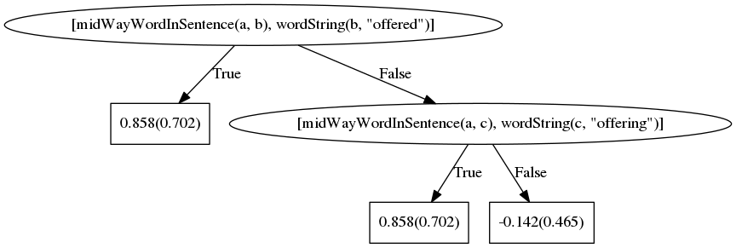
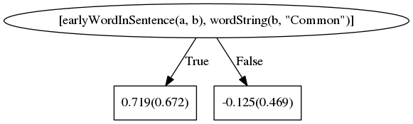

Slide 11
Future extensions
File upload option (currently the files from local machine are used)
Backend with database for storing positive examples and documents (can be extended using SQLAlchemy python library)
GUI can be improved using React JS

